Slide 1


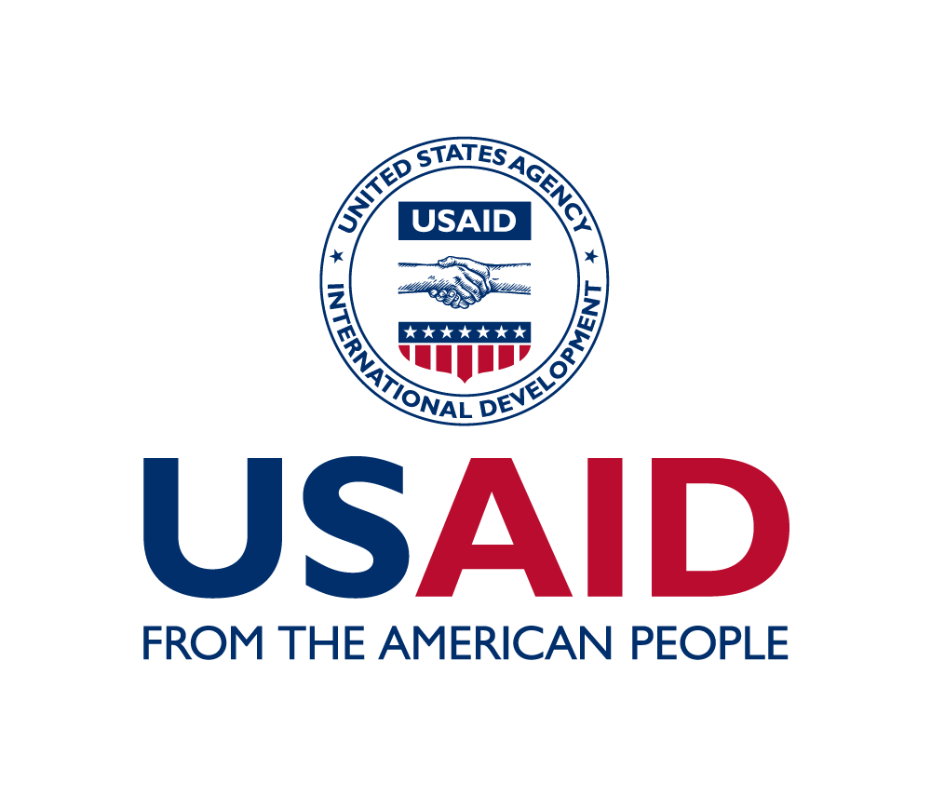
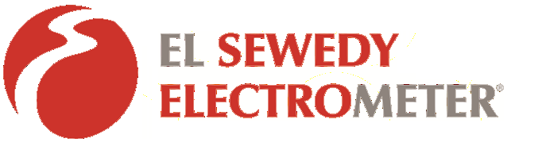
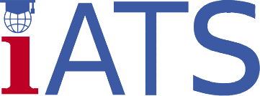
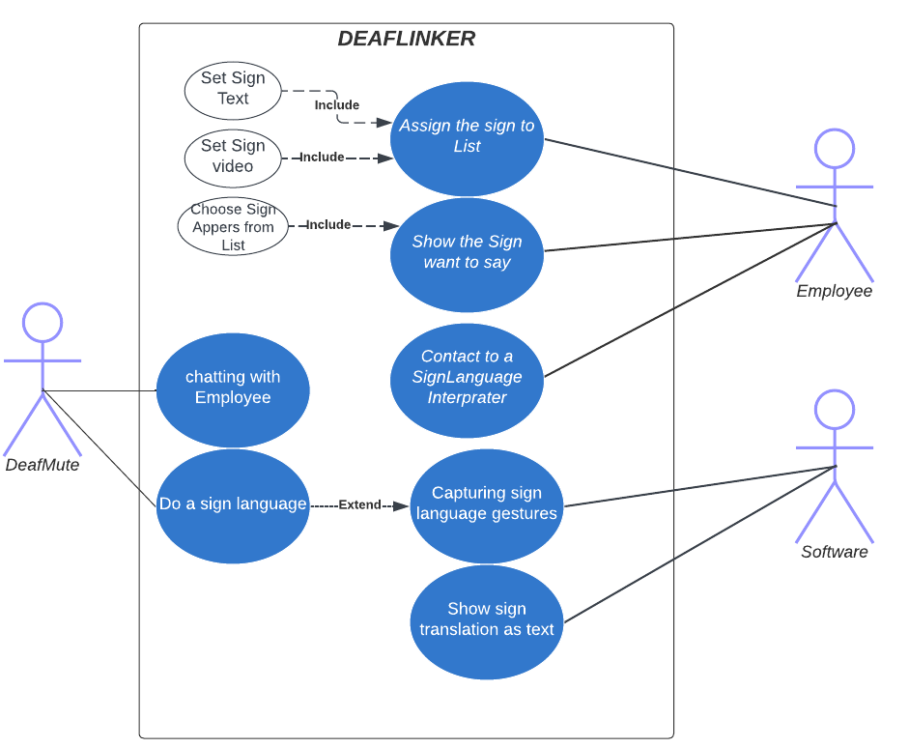
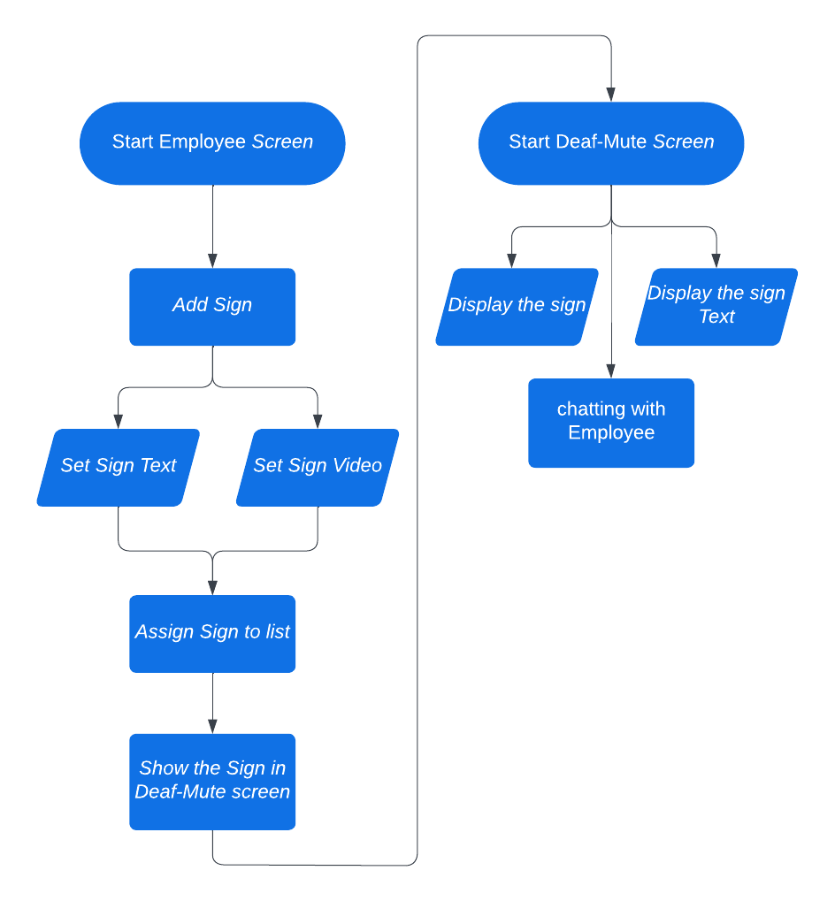
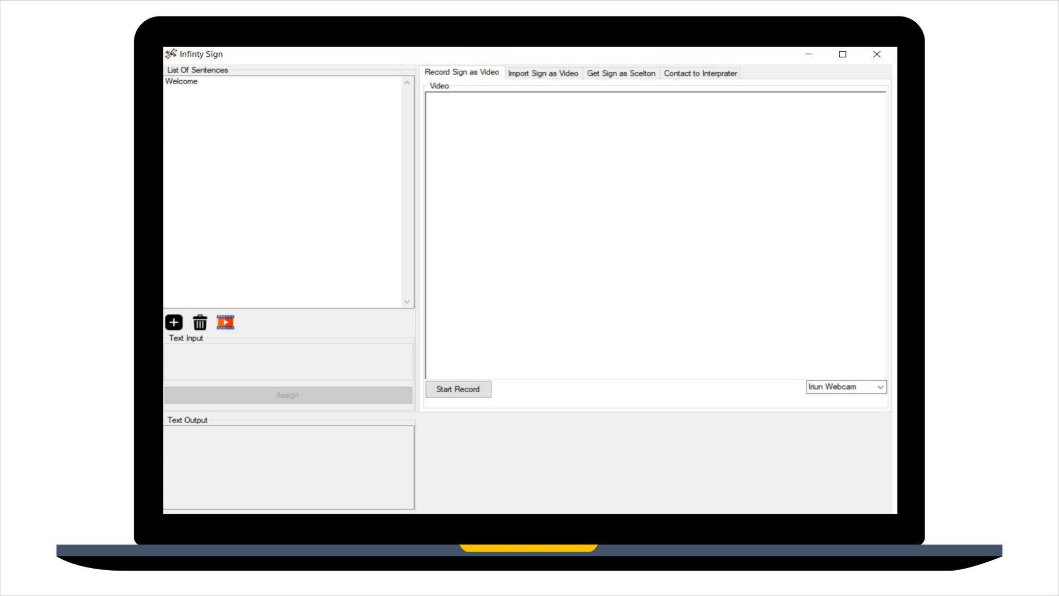
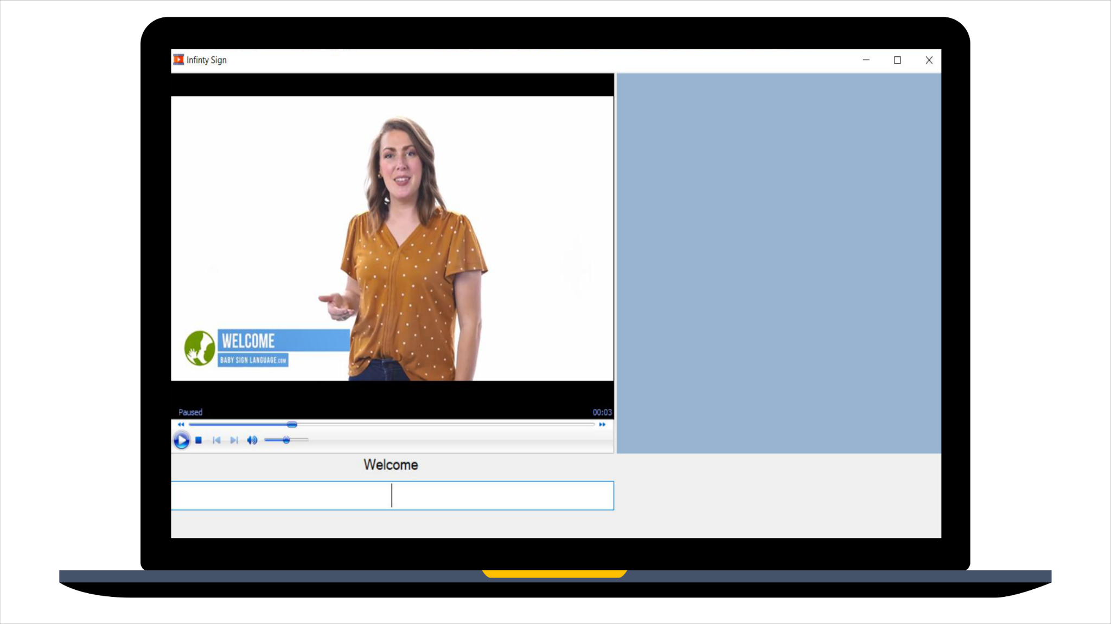
Sign Assist
Students Names: Ammar Ahmad - Magdy Emad
Project Code: (SOFT)
Abstract
Results and data analysis
Conclusions
The problem is How can we facilitate communication between deaf-mute individuals, and the employees in places they visit, such as government institutions and private sectors, where sign language interpreters are not readily available?
By developing technology that can accurately convert written or spoken language into sign language and vice versa
This app communication between deaf and mute people and employees In government departments and private sectors .
So, we can bridge the communication gap and enable deaf and mute individuals to express themselves and interact more seamlessly with the hearing world. This innovative solution has the potential to promote inclusivity, promote better understanding and promote equal opportunities for the deaf and mute community.We can face some difficulties in the application by: recommendation from the users or feedback
We conducted a survey involving and communicated with a school for the deaf and mute. The respondents expressed their approval of the idea and its potential to ease communication between the deaf, mute, and employees in the places they visit. This approach also reduces the need for on-site sign language interpreters, conserving effort and finances. we found recommendation about survey to provide a version for mobile app
Our application addresses the critical issue of communication barriers faced by deaf-mute individuals in government departments and private sectors. By leveraging technology to convert language into sign language, the app aims to bridge the communication gap, fostering inclusivity and equal opportunities. The project's user-centric approach, with a commitment to feedback-driven improvements, emphasizes simplicity in UI, enhanced performance, and expanded accessibility in mobile and educational settings.
Introduction
Prototype
Recommendation
About 70 million people around the world with disabilities who are deaf-mute or hard of hearing use sign language to communicate and that is understandable from normal people; they are an essentially important category in our society.
So to what extent does a desktop application that is available in government institutions and private sectors contribute to facilitating successful process communication between the deaf-mute individuals, and employees in these places they visit?
So, our software desktop application provides some features to solve this problem like sign language interpreter contact, real-time gestures recognition, and chatting by the text Also the application is based on two screen monitors, one for normal users and a second for deaf-mute users to makes it functionality easter.
we also have some recommendation in the future such as:
1.Improve the application based on feedback.
2.Develop a user-friendly interface using advanced frameworks like the WPF framework.
3.Increase application performance by collecting more Data and Resources about sign language
4.Availability of a version of the application for Mobile about QR Code to connect from app to mobile app.
References
Methods and Materials
United Nations. (2022). International Day of Sign Languages 23 September.
URL: https://www.un.org/en/observances/sign-languages-day.
babysignlanguage: EASIEST WAY TO TEACH YOUR BABY TO SIGN.
URL: https://babysignlanguage.com/dictionary/welcome/#:~:text=Welcome
Sign Translate. (22 July 2021), from Google URL: https://sign.mt/
Survey:
https://docs.google.com/forms/d/17y1ck_7hhyikzfK2fie01_yvMV4XVVR8HDRbWBtUUjQ/edit
Visual Studio Community IDE(integrated development environment)
Windows Form Application for project development
Csharp programming language to code the application

